Slide 1
Homebrewing for Beginners
A basic introduction to my web page!

Slide 2
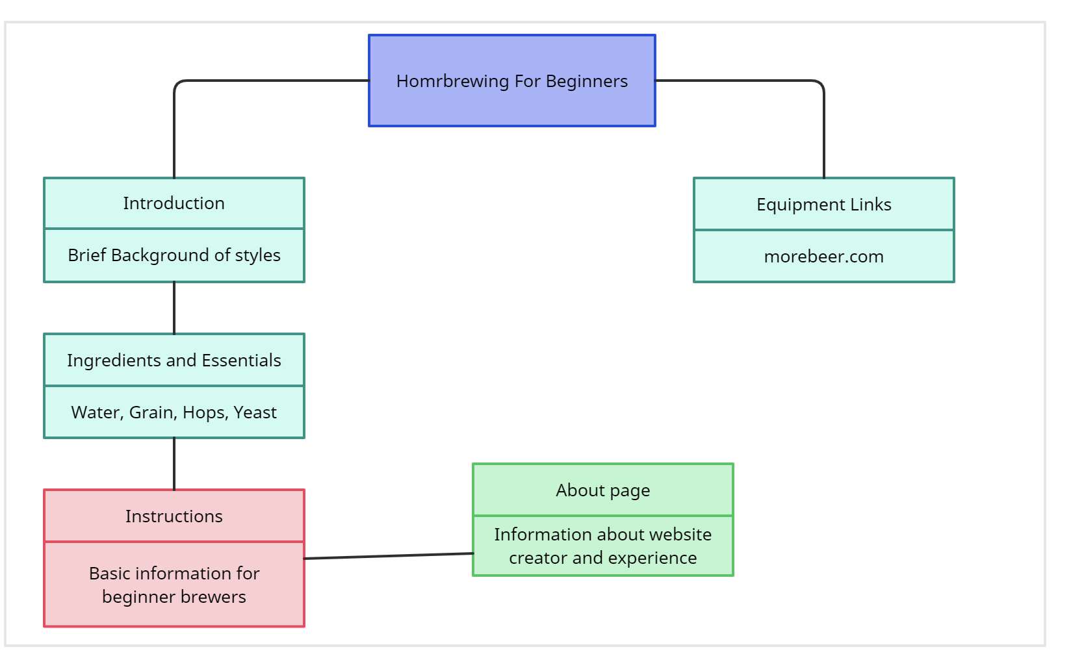
Object Diagram
In this diagram, I began the process in deciding how I wanted to design my web page and how it would flow. Through several different edits, I ultimately finished with a different build that originally anticipated, but this diagram was the building block of my final design.

Slide 3

Learning HTML and CSS with SoloLearn
Using the SoloLearn app, I was able to teach myself basic coding language in my spare time.
This Photo by Unknown Author is licensed under CC BY-SA-NC

Slide 4
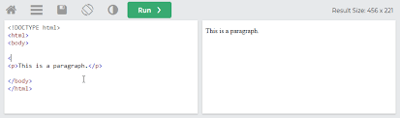
Testing
Using www.w3schools.com, I was able to use the Tryit feature on the site to test all my code and look for any errors or ways I could improve the overall look and flow of my web page.

